Slide 1

Evaluating Sentiment Classification Techniques on Social and Movie Review Data
NAME : Deekshitha Chowdary Kalluri
COURSE: CIS 732 – Machine Learning
DATE: 5/14/2025

Slide 2

INTRODUCTION
What is Sentiment Analysis?
Sentiment analysis is a natural language processing task that involves determining whether a piece of text expresses a positive, negative, or neutral sentiment. It is often referred to as opinion mining.
Why Does It Matter?
Reviews: Helps businesses understand customer satisfaction from product or movie reviews.
Social Media: Enables real-time monitoring of public opinion on platforms like Twitter.
Customer Feedback: Automates survey or comment analysis for service improvement.
Project Goal
The goal of this project is to evaluate and compare the performance of traditional machine learning models (like Logistic Regression and LinearSVC) and modern deep learning models (LSTM and BERT) for classifying IMDb movie reviews into positive or negative sentiments.

Slide 3

STATEMENT
Objective of the Project
Train and evaluate four classifiers:
  Logistic Regression
  Linear SVC
  LSTM
  BERT
Key Questions
Which model performs best with limited data?
How do deep learning and transformer models compare to ML baselines?

Slide 4
DATASET & PROCESSING
Dataset: IMDb movie reviews (500 samples)
Balanced positive/negative classes
Preprocessing steps:
HTML stripping (BeautifulSoup)
Lowercasing
TF-IDF or tokenization (depending on model)

Slide 5
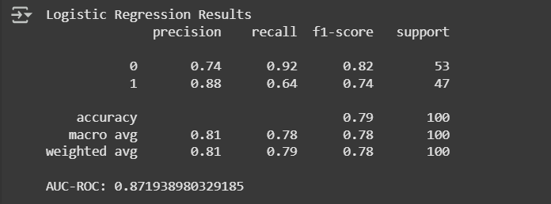
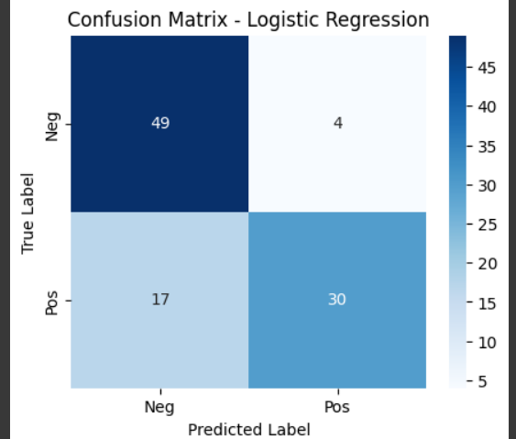
Model 1 – Logistic Regression
Trained on TF-IDF features
Accuracy: 0.79
F1 Score: 0.78
AUC-ROC: 0.87
Performed better on negative class

Slide 6
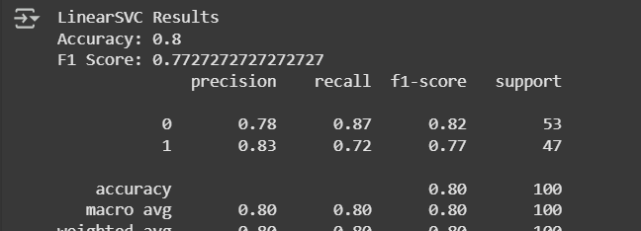
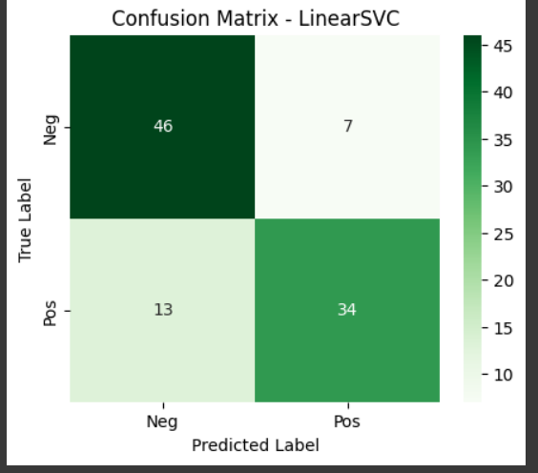
MODEL 2- LinearSVC
Slightly outperformed Logistic Regression
Accuracy: 0.80
F1 Score: 0.78
More balanced precision and recall
Effective on sparse, vectorized data

Slide 7
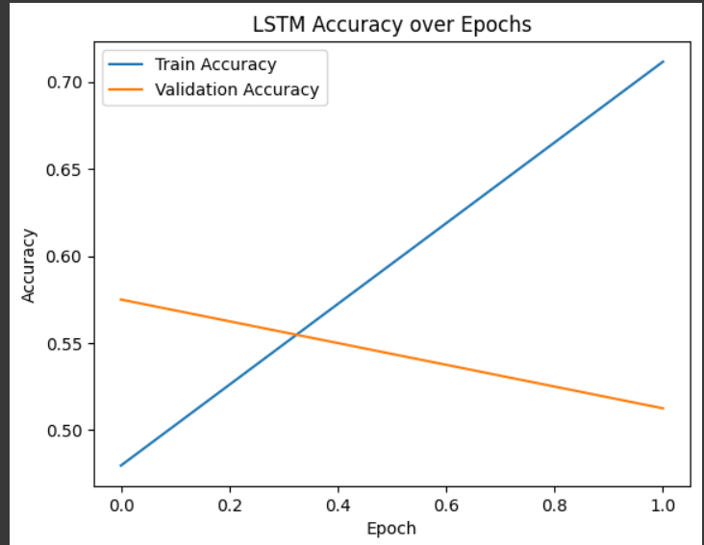
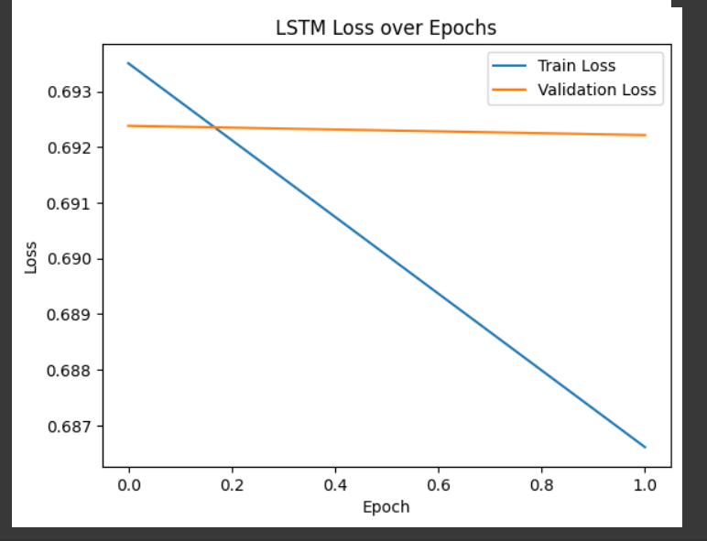
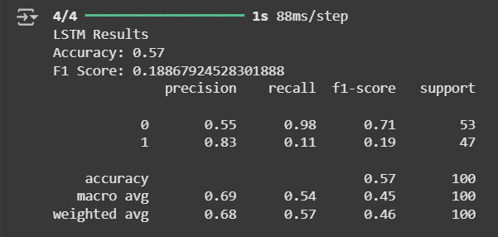
MODEL 3- LSTM
Keras model with embedding + LSTM
Training accuracy: 0.69
Test accuracy: 0.57
F1 Score: 0.19
Underfitted due to small dataset and 2 epochs

Slide 8
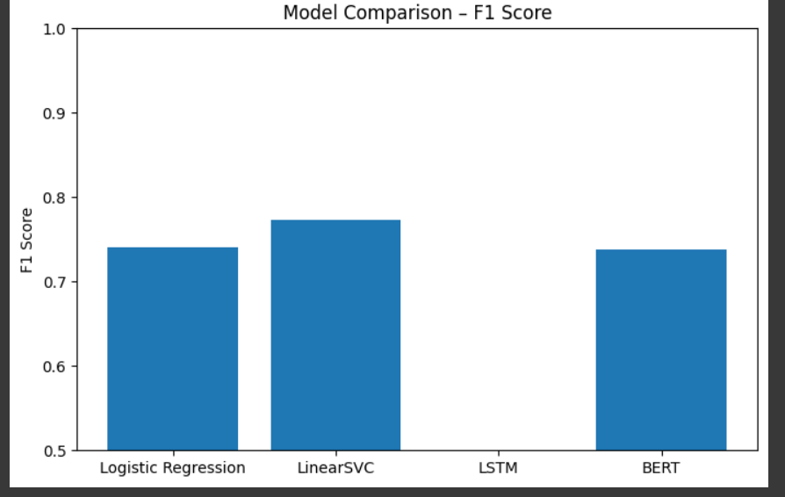
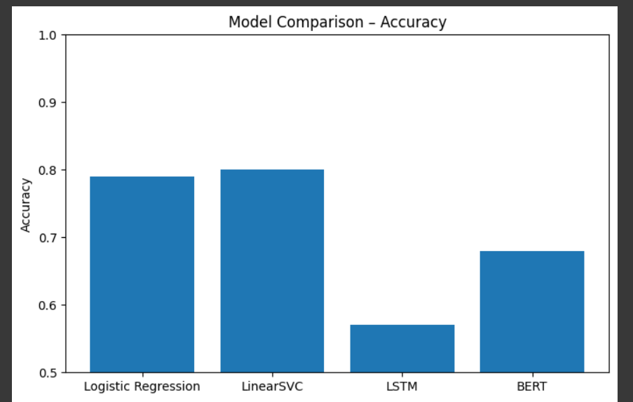
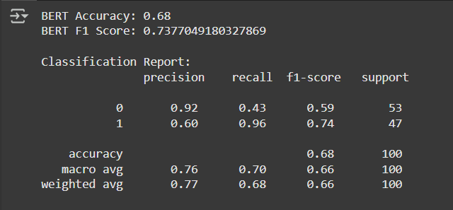
MODEL 4 - BERT
Fine-tuned bert-base-uncased
Train time: ~17 minutes
Accuracy: 0.68
F1 Score: 0.74
High recall for positive class, but poor balance

Slide 9
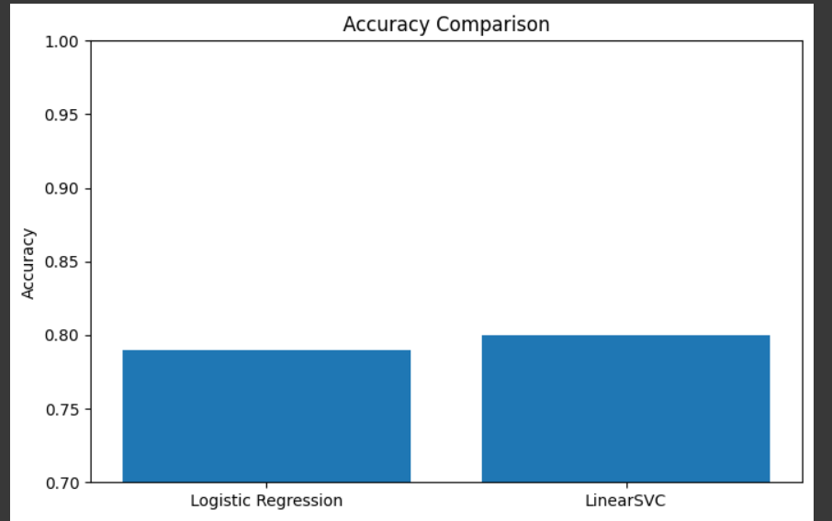
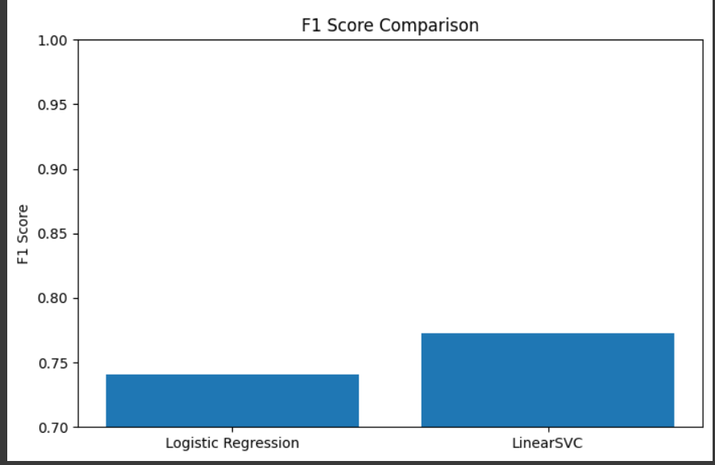
METRICS USED
Accuracy: Correct predictions / Total
F1 Score: Balance between precision and recall
Confusion Matrix: Insight into true/false positives/negatives
Bar charts shown for quick comparison

Slide 10
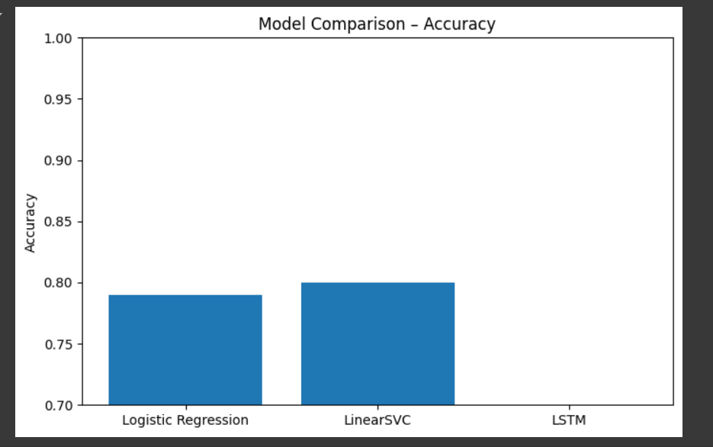
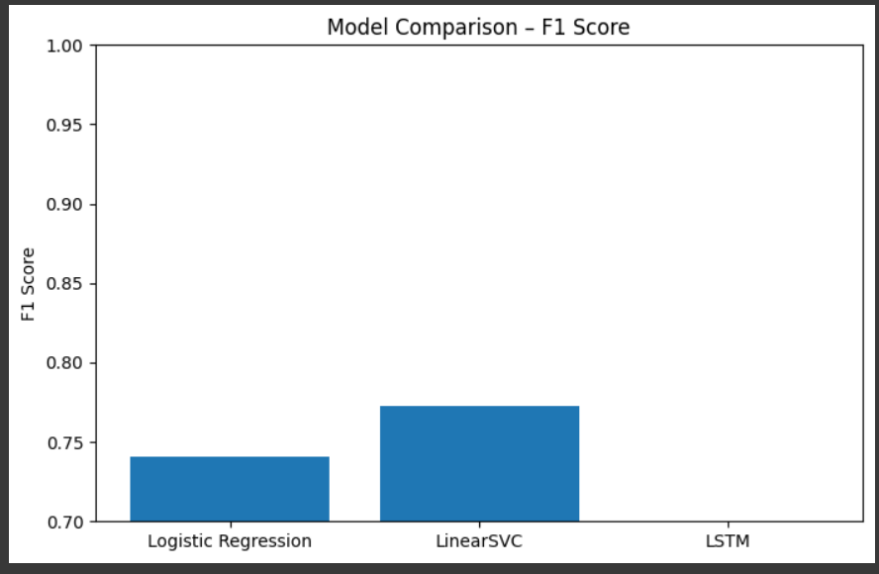
RESULTS – ACCURACY & F1
Logistic Regression and LinearSVC were top performers
LSTM underperformed
BERT strong on F1, weak on accuracy

Slide 11
OBSERVATIONS
Classical ML models work well on small, cleaned data
LSTM needs more data and epochs
BERT shows potential but over-predicts one class
Trade-offs between training time and generalization

Slide 12
CONCLUSION
LinearSVC was the most consistent performer
Deep learning didn’t help much due to data limits
Future work: longer training, larger dataset, RoBERTa, hyperparameter tuning

Slide 13
SOURCES
List key sources (shortened format):
IMDb Dataset (Kaggle, 2018)
Devlin et al., BERT (2019)
Ramos, TF-IDF (2003)
Scikit-learn, Hugging Face, Keras, TensorFlow

Slide 14

Q&A

